Slide 1


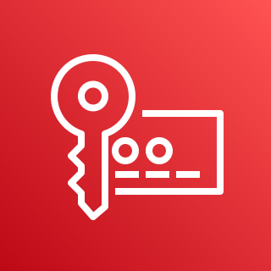




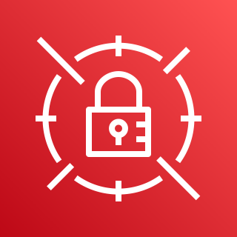



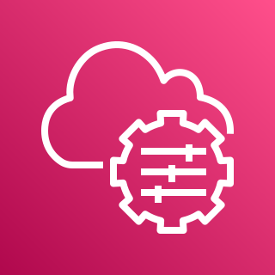



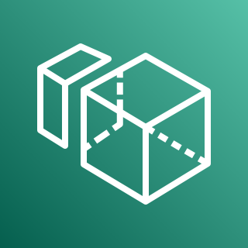
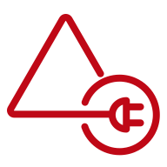
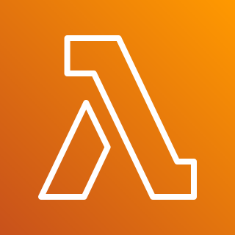
Amazon WorkSpaces Quick Start – Self-Managed AD
AWS Cloud
Region
Availability Zone 1
Availability Zone 2
VPC
AWS Key Management Service (AWS KMS)
Internet gateway
Public subnet
Public subnet
Auto Scaling group
NAT gateway
RD Gateway
RD Gateway
NAT gateway
AWS Secrets Manager
Private subnet
Private subnet
Application Load Balancer
Auto Scaling group
AWS Systems Manager
Domain Controller 1
RADIUS Server
RADIUS Server
Domain Controller 2
Amazon EventBridge
Amazon Aurora
Amazon WorkSpaces
AD Connector
Amazon WorkSpaces
AWS Lambda

Slide 2

Amazon WorkSpaces Quick Start – AWS Managed AD
AWS Cloud
Region
Availability Zone 1
Availability Zone 2
VPC
AWS Key Management Service (AWS KMS)
Internet gateway
Public subnet
Public subnet
Auto Scaling group
NAT gateway
RD Gateway
RD Gateway
NAT gateway
AWS Secrets Manager
Private subnet
Private subnet
Application Load Balancer
Auto Scaling group
AWS Systems Manager
Management
AWS Managed Microsoft AD
RADIUS Server
RADIUS Server
AWS Managed Microsoft AD
Amazon EventBridge
Amazon Aurora
Amazon WorkSpaces
Amazon WorkSpaces
AWS Lambda

Slide 3

Amazon WorkSpaces Quick Start – Self-Managed AD
AWS Cloud
Region
Availability Zone 1
Availability Zone 2
VPC
AWS Key Management Service (AWS KMS)
Internet gateway
Public subnet
Public subnet
Auto Scaling group
NAT gateway
RD Gateway
RD Gateway
NAT gateway
AWS Secrets Manager
Private subnet
Private subnet
Application Load Balancer
Auto Scaling group
AWS Systems Manager
RADIUS Server
RADIUS Server
Amazon Aurora
Amazon EventBridge
Amazon WorkSpaces
AWS Directory Service
Amazon WorkSpaces
AWS Lambda

